Slide 1
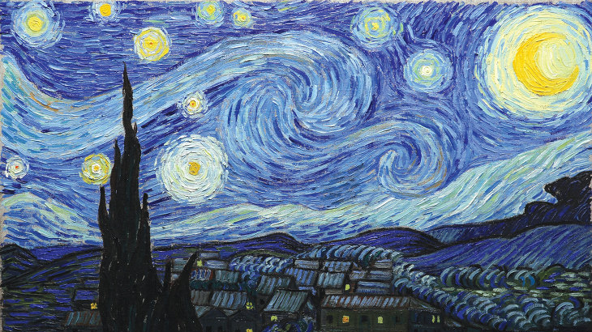
Neural-Style-Transfer
Lee Kang Ro

Slide 2
Index
● Neural-Style-Transfer ?
● VGG19 ?
● HOW ?

Slide 3
Neural-Style-Transfer ?

Slide 4
Neural-Style-Transfer ?
Style Transfer
↓
transfer from A`s style to B`s style

Slide 5
Neural-Style-Transfer ?
Neural
Style Transfer
↓
transfer from A`s style to B`s style
using Deep-learning model

Slide 6
A : What ‘model’ did you use ?
B :
VGG19

Slide 7
A : What ‘model’ did you use ?
B :
VGG19 ?

Slide 8

VGG19 ?
VGG19
↓
‘one of VGG series’
‘Image In Class Out’
‘like function’
‘pre-trained model’

Slide 9

VGG19 ?
VGG19
↓
‘one of VGG series’
‘Image In Class Out’
‘like function’
‘pre-trained model’
VGG19
Cat ?
Dog ?

Slide 10
VGG19 ?
VGG19
Cat ?
Dog ?

Slide 11
VGG19 ?
VGG19
but we don’t use
class layer
Cat ?
Dog ?

Slide 12
VGG19 ?
vgg19 model
layer1
layer2
layer3
...
layer#
Cat ? Dog ?

Slide 13
VGG19 ?
vgg19 model
layer1
layer2
we will use layers
layer3
...
layer#
Cat ? Dog ?

Slide 14
vgg19 model
layer1
layer2
HOW ?
we will use layers
layer3
...
layer#
Cat ? Dog ?

Slide 15
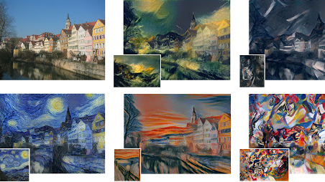
HOW ?
target
image
layer1
Input target
in VGG19
layer2
layer3
...
layer#

Slide 16
HOW ?
target image
layer1
Input target
in VGG19
layer2
layer3
...
layer#

Slide 17
HOW ?
target image
layer1
Input target
in VGG19
layer2
layer3
...
layer#

Slide 18
HOW ?
target image
layer1
Input target
in VGG19
layer2
layer3
...
save !
layer#

Slide 19
HOW ?
target image
style
image
layer1
layer1
Input style
in VGG19
layer2
layer2
layer3
layer3
...
...
save !
layer#
layer#

Slide 20
HOW ?
style image
target image
layer1
layer1
Input style
in VGG19
layer2
layer2
layer3
layer3
...
...
save !
layer#
layer#

Slide 21
HOW ?
style image
target image
layer1
layer1
Input style
in VGG19
layer2
layer2
layer3
layer3
...
...
save !
layer#
layer#

Slide 22
HOW ?
style image
target image
save !
layer1
layer1
Input style
in VGG19
layer2
layer2
layer3
layer3
...
...
save !
layer#
layer#

Slide 23
HOW ?
target image
style image
target image
save !
And
Input target
in VGG19
layer1
layer1
layer1
layer2
layer2
layer2
layer3
layer3
layer3
...
...
...
save !
layer#
layer#
layer#

Slide 24
HOW ?
target image
style image
target image
Train
toward goal
layer1
layer1
layer1
layer2
layer2
layer2
layer3
layer3
layer3
...
...
...
layer#
layer#
layer#

Slide 25
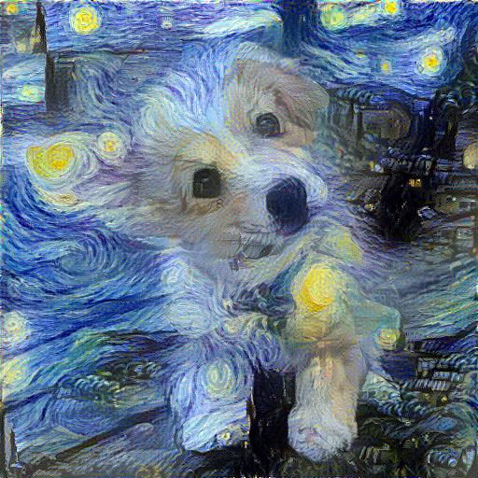
HOW ?
target image
style image
target image
Train
toward goal
layer1
layer1
layer1
layer2
layer2
layer2
layer3
layer3
layer3
...
...
...
layer#
layer#
layer#

Slide 26
HOW ?
Complete !

Slide 27
Thanks !

